Slide 1





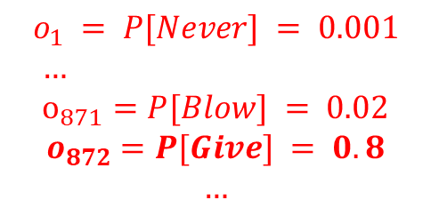







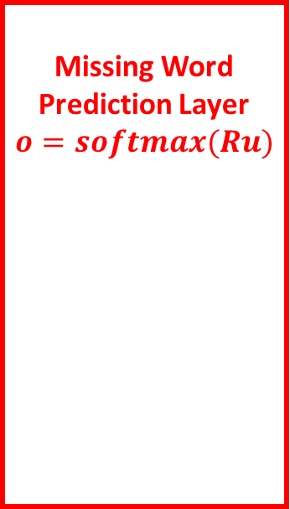
Embedding Layer
$$∀i, v_{i}=We_{i}$$
$$e_{1}$$
Never
…
$$v_{1}$$
Context Aggregation Layer
$$u=\sum_{k}{v_{k}}$$
Missing Word
Prediction Layer
$$o=softmax(Ru)$$
$$e_{2}$$
$$v_{2}$$
Gonna
…
2k words (missing a middle word), showing $k=2.$
Predict by choosing word with highest probability, e.g. “Give”
$$u$$
…
$$e_{3}$$
$$v_{3}$$
You
…
$${∀i, o}_{i} = P[word_{i}]$$
$$v_{4}$$
$$o_{1} = P[Never] = 0.001$$
$$… \\ o_{871}=P[Blow] = 0.02$$
$$o_{872}=P[Give] = 0.8$$
$$…$$
…
$$e_{4}$$
Up

Slide 2
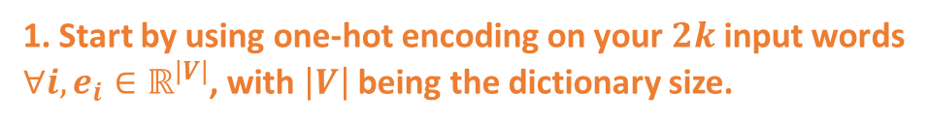
Embedding Layer
$$∀i, v_{i}=We_{i}$$
1. Start by using one-hot encoding on your $2k$ input words
$∀i, e_{i}∈ℝ^{\left|V\right|}$, with $\left|V\right|$ being the dictionary size.
$$e_{1}$$
Never
…
$$v_{1}$$
Context Aggregation Layer
$$u=\sum_{k}{v_{k}}$$
Missing Word
Prediction Layer
$$o=softmax(Ru)$$
$$e_{2}$$
$$v_{2}$$
Gonna
…
2k words (missing a middle word), showing $k=2.$
Predict by choosing word with highest probability, e.g. “Give”
$$u$$
…
$$e_{3}$$
$$v_{3}$$
You
…
$${∀i, o}_{i} = P[word_{i}]$$
$$v_{4}$$
$$o_{1} = P[Never] = 0.001$$
$$… \\ o_{871}=P[Blow] = 0.02$$
$$o_{872}=P[Give] = 0.8$$
$$…$$
…
$$e_{4}$$
Up

Slide 3

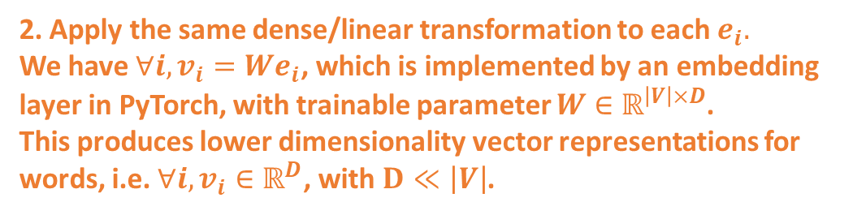
Embedding Layer
$$∀i, v_{i}=We_{i}$$
2. Apply the same dense/linear transformation to each $e_{i}.$
We have $∀i, v_{i}=We_{i}$, which is implemented by an embedding layer in PyTorch, with trainable parameter $W∈$ $ℝ^{\left|V\right|×D}$.
This produces lower dimensionality vector representations for words, i.e. $∀i, v_{i}∈ℝ^{D}$, with $D≪\left|V\right|$.
$$e_{1}$$
Never
…
$$v_{1}$$
Context Aggregation Layer
$$u=\sum_{k}{v_{k}}$$
Missing Word
Prediction Layer
$$o=softmax(Ru)$$
$$e_{2}$$
$$v_{2}$$
Gonna
…
2k words (missing a middle word), showing $k=2.$
Predict by choosing word with highest probability, e.g. “Give”
$$u$$
…
$$e_{3}$$
$$v_{3}$$
You
…
$${∀i, o}_{i} = P[word_{i}]$$
$$v_{4}$$
$$o_{1} = P[Never] = 0.001$$
$$… \\ o_{871}=P[Blow] = 0.02$$
$$o_{872}=P[Give] = 0.8$$
$$…$$
…
$$e_{4}$$
Up

Slide 4
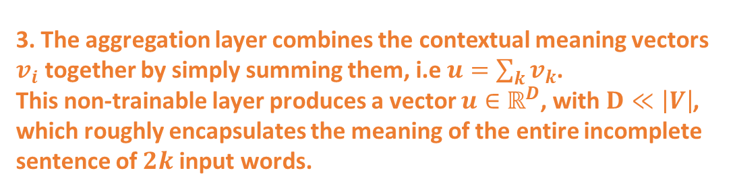
Embedding Layer
$$∀i, v_{i}=We_{i}$$
3. The aggregation layer combines the contextual meaning vectors $v_{i}$ together by simply summing them, i.e $u=\sum_{k}{v_{k}}$.
This non-trainable layer produces a vector $u∈ℝ^{D}$, with $D≪\left|V\right|$, which roughly encapsulates the meaning of the entire incomplete sentence of $2k$ input words.
$$e_{1}$$
Never
…
$$v_{1}$$
Context Aggregation Layer
$$u=\sum_{k}{v_{k}}$$
Missing Word
Prediction Layer
$$o=softmax(Ru)$$
$$e_{2}$$
$$v_{2}$$
Gonna
…
2k words (missing a middle word), showing $k=2.$
Predict by choosing word with highest probability, e.g. “Give”
$$u$$
…
$$e_{3}$$
$$v_{3}$$
You
…
$${∀i, o}_{i} = P[word_{i}]$$
$$v_{4}$$
$$o_{1} = P[Never] = 0.001$$
$$… \\ o_{871}=P[Blow] = 0.02$$
$$o_{872}=P[Give] = 0.8$$
$$…$$
…
$$e_{4}$$
Up

Slide 5
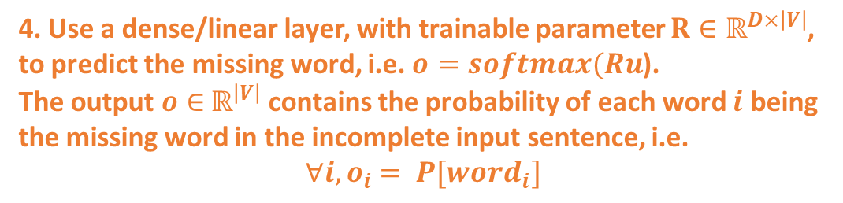
Embedding Layer
$$∀i, v_{i}=We_{i}$$
4. Use a dense/linear layer, with trainable parameter $R∈ℝ^{D×\left|V\right|}$, to predict the missing word, i.e. $o=softmax(Ru$).
The output $o∈$ $ℝ^{\left|V\right|}$ contains the probability of each word $i$ being the missing word in the incomplete input sentence, i.e.
$${∀i, o}_{i} = P[word_{i}]$$
$$e_{1}$$
Never
…
$$v_{1}$$
Context Aggregation Layer
$$u=\sum_{k}{v_{k}}$$
Missing Word
Prediction Layer
$$o=softmax(Ru)$$
$$e_{2}$$
$$v_{2}$$
Gonna
…
2k words (missing a middle word), showing $k=2.$
Predict by choosing word with highest probability, e.g. “Give”
$$u$$
…
$$e_{3}$$
$$v_{3}$$
You
…
$${∀i, o}_{i} = P[word_{i}]$$
$$v_{4}$$
$$o_{1} = P[Never] = 0.001$$
$$… \\ o_{871}=P[Blow] = 0.02$$
$$o_{872}=P[Give] = 0.8$$
$$…$$
…
$$e_{4}$$
Up

Slide 6

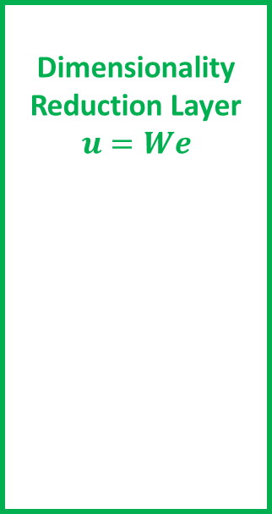
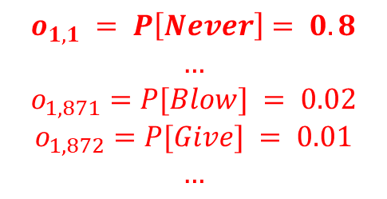


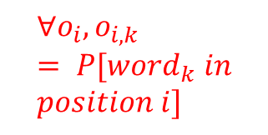

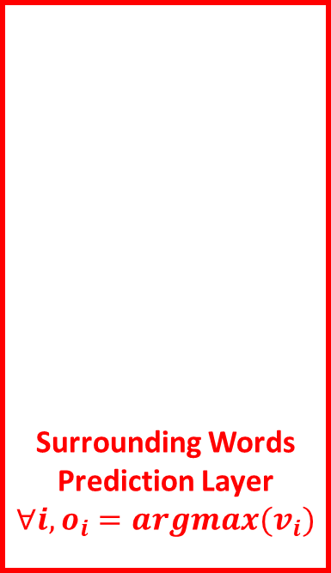



Prediction Layer
$$∀i, v_{i}=R_{i}u$$
Surrounding Words
Prediction Layer
$$∀i, o_{i}=argmax(v_{i})$$
Predict by choosing word with highest probability, e.g. “Never”
$$v_{1}$$
…
Dimensionality Reduction Layer
$$u=We$$
$${∀o_{i}, o}_{i,k} = P[word_{k} in \\ position i]$$
$$v_{2}$$
$$e$$
$$u$$
Give
…
$$v_{3}$$
$$o_{1, 1} = P\left[Never\right]= 0.8$$
$$…$$
$$o_{1,871}=P[Blow] = 0.02$$
$$o_{1,872}=P[Give] = 0.01$$
$$…$$
$$v_{4}$$

